Slide 1
The Truth Will Set You Free John 8:32
Lake Gibson
March 31, 2019

Slide 4
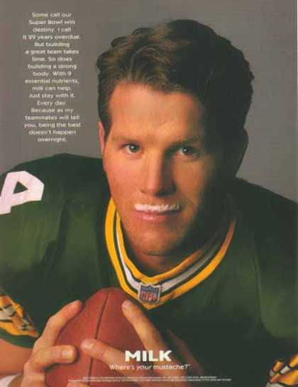

Slide 7
Three Lessons Concerning Truth From John 8:31-32
There is Truth.
Truth comes through Jesus Christ.
The Truth will set you free.

Slide 8
1. There Is Truth
We live in a world where truth is considered to be “relative.”
“There is one thing a professor can be absolutely certain of: almost every student entering the university believes, or says he believes, that truth is relative. … The students, of course, cannot defend their opinion. It is something with which they have been indoctrinated.” (Francis Beckwith)

Slide 9
Francis Beckwith: The growth of moral relativism “has been so subtle and thorough that it is now a core belief – not just of the college elite, but also of the rank and file, white collar and blue collar alike.”
Folks say: “What is true for you is not necessarily true for me.”
Or, “That’s your truth, not my truth.”

Slide 10
The Barna Group research reports that 81% of young people have adopted the view that “truth is relative to his or her circumstances.”
“As a society we have adopted the philosophy of Friedrich Nietzsche, “You have your way. I have my way. As for the right way, the correct way, and the only way, it does not exist.” (Francis Beckwith)
“There is no truth with a capital T.”

Slide 11
This philosophy is not new – it is the same belief held by Pilate, Roman governor.
“What is truth?” (John 18:33-38)
The reality is – that there are none that really believe that truth is completely relative. They all believe that there is “truth” in certain areas.
Ask them about “global warming.”
Ask them about abortion.
Ask them about animal rights.
“I think it is immoral to have children today.”

Slide 12
Jesus Believed In and Taught An Absolute Standard
“And ye shall know the truth, and the truth shall make you free.” (8:32)
“Sanctify them in the truth, thy word is truth.” (17:17)
“To this end have I been born, and to this end am I come into the world, that I should bear witness unto the truth.” (18:37)

Slide 13
2. Truth Comes Through Jesus
John 1:14-18 – “For the law was given through Moses, grace and truth came through Jesus Christ.”
“If ye abide in my word, then are ye truly my disciples; and ye shall know the truth and the truth shall make you free.” (John 8:31-32).
“I speak the things which I have seen with my Father” (v. 38).

Slide 14
“Ye seek to kill me a man that hath told you the truth, which I heard from God” (40, see 8:26, 12:49, 15:15, 1:14)
“I am the way, and the truth, and the life, no one cometh unto the Father, but by me.” (14:6)
“Sanctify them in the truth, thy word is truth.” (17:17)

Slide 15
Are We Really Listening To Jesus?
There are many voices out there.
Teachers and preachers who preach a variety of “gospels” (Gal. 1:6-10).
Traditions of men (Matt. 15:1-9)
Col. 2:8 - “See to it that no one takes you captive through philosophy and empty deception, according to the tradition of men, according to the elementary principles of the world, rather than according to Christ.”

Slide 16
3. The Truth Will Set You Free
The Jews’ reaction: “We … have never been in bondage to any man” (vs. 33).
Jesus’ answer: “Everyone who commits sin is the slave of sin.” (vs. 34)
“So if the Son makes you free, you will be free indeed.” (vs. 36)

Slide 17
Truth Brings Real Freedom
Freedom from ignorance (Acts 17:23)
Freedom from sin (Rom. 3:21-25)
Freedom from guilt (Rom. 5:1-2)
Freedom from worry (Matt. 6:25-34)
Freedom from fear (Heb. 2:14-15)

Slide 18
“If therefore the Son shall make you free, ye shall be free indeed.” (ASV, John 8:36)
ὀλίγως, ὄντως; AV translates as “indeed” six times, “certainly” once, “of a truth” once, “verily” once.
“truly, in reality, in point of fact, as opposed to what is pretended, fictitious, false, conjectural.” (Strong)

Slide 20
Introduction
Advertising works.
Getting your message out.
Changing people’s minds
Making an impression
Think of some famous advertising campaigns

