Slide 1
How We Got the Bible
Lesson 2
The Birth of the Bible
Lake Gibson
December 8, 2021

Slide 2
Lesson 1 – The Making of Ancient Books
Early writing (man had written language from a very early time – Mesopotamia, Egypt, China)
Writing Materials
Not only Interesting, but important, to understand the whole process.
Stone, clay, wood & wax, metals.
Papyrus, Parchment & Vellum
How did we get from “generic writing” to a collection of books known as “the Bible?”
We will look at some more pieces of the puzzle.

Slide 3
The Birth of the Bible (p. 21)
Read opening paragraph (p. 21)
“The Bible is a collection of books”
That “collection” came about gradually over many years. (OT – 1450-400 B.C.)
66 books – App. 40 authors over 1500 years
Bible (biblia) – “the books”
The history and development of the Bible is of greatest importance to the child of God because “all Scripture is inspired of God” (2 Tim. 3:16-17).

Slide 4
The Form of Ancient Books
The Scroll (roll, leather or papyrus)
Papyrus sheets would be glued end to end to make it into a sheet long enough to roll up.
Writing typically done on one side.
With papyrus sheets, there was a “good side” and a “bad” side. The good side was writing “with the grain.” Occasionally both sides would be used (Rev. 5:1).
The writing arranged in columns (3” to 4” wide)
Scrolls were various lengths (about 35’ max).

Slide 5
A larger book (Matthew, Luke or Acts) could be put on one scroll (33’ to 35’).
But obviously, the whole NT could not be put on a single scroll.
Just as papyrus gave way to parchment, the scroll gave way to the codex (book).
Much more convenient.
Could be written on both sides of a page.
“The result was a book that could be easily read, easily referred to, and easily carried about.” (22)
More information in one book; all gospels, all of Paul’s epistles, etc. Later – entire N.T. or Bible.

Slide 6
“It has been said that the inventor of the codex belongs with other nameless benefactors of mankind such as the inventor of the wheel and the deviser of the alphabet.” (p. 22)
Read page 23, 1st para. – “When did the codex displace the roll?”
“More and more it seems that the codex may well have been a Christian invention. If not, we know at least that Christians were the first to made extensive use of the codex.”

Slide 7
Early Form of the Bible
God’s first communications were oral in nature.
But it was God’s purpose that a written record of His instructions be given (for Israel and later the church).
Six specific writings are attributed to Moses (see p. 23)
Many Bible references make it clear that Moses was the author of the first five books of the OT (Josh. 8:31-32; 2 Kings 14:6, Ezra 6:18, Luke 2:22, Mark 12:26, John 7:19). (Last two Jesus)

Slide 8
Others Wrote God’s Laws
“So Joshua made a covenant with the people that day and made for them a statute and an ordinance in Shechem. 26 And Joshua wrote these words in the book of the law of God; and he took a large stone and set it up there under the oak that was by the sanctuary of the LORD.” (Josh. 24:25-26, NASB)

Slide 9
1 Samuel 10:25 – “Then Samuel told the people the ordinances of the kingdom and wrote them in the book and placed it before the LORD. And Samuel sent all the people away, each one to his house.”
Jeremiah 36:2 – “Take a scroll and write on it all the words which I have spoken to you concerning Israel and concerning Judah, and concerning all the nations, from the day I first spoke to you, from the days of Josiah, even to this day.

Slide 10
Lightfoot, p. 24
“In this way the OT Scriptures grew gradually and came to be assembled into an accepted collection about the time of Ezra (c. 400 B.C.). The Jewish authority, Josephus, said that no book was added to the Hebrew Scriptures after the time of Malachi.”
Through the HS’s guidance, men were inspired to write God’s message (2 Pet. 1:21).
The Hebrew nation recognized the importance of these writings and over time collected them together.

Slide 11
The New Testament
The NT also grew in the same manner, but over a much shorter period of time (50-100 AD).
The writings of the apostles and inspired prophets were accepted immediately and seen as authoritative.
We will learn later about why certain books were accepted and why others were not. This is the process of the development of the Canon.

Slide 12
The Form of our Bible Today (66)
Old Testament (39)
Law (Gen. – Deut.) 5
History (Joshua-Esther) 12
Poetry and Wisdom (Job-Song of Solomon) 5
Major Prophets (Isaiah-Daniel) 5
Minor Prophets (Hosea-Malachi) 12
New Testament (27)
Gospels (Matthew-John) 4
History (Acts) 1
Epistles (Romans-Jude) 21
Prophecy (Revelation) 1

Slide 13
Hebrew Divisions of the OT (24 books)
Law (Gen. – Deut.) 5
Prophets
Former Prophets: Joshua, Judges, 1 & 2 Sam., 1 & 2 Kings 4
Latter Prophets: Isaiah, Jeremiah, Ezekiel, the Book of the Twelve 4
Writings: Job, Psalms, Proverbs, Ecclesiastes, Song of Solomon, Ruth, Lamentations, Esther, Daniel, Ezra-Nehemiah, 1 & 2 Chronicles. 11

Slide 14
Languages of the Bible
Hebrew
A Semitic language (along with Aramaic, Syriac, Akkadian, Arabic)
Written “backwards” (right to left)
It is an alphabetic script, but it looks very different than our Indo-European languages.
Originally written without vowels (still does not have vowels, but has vowel “points.”)

Slide 15
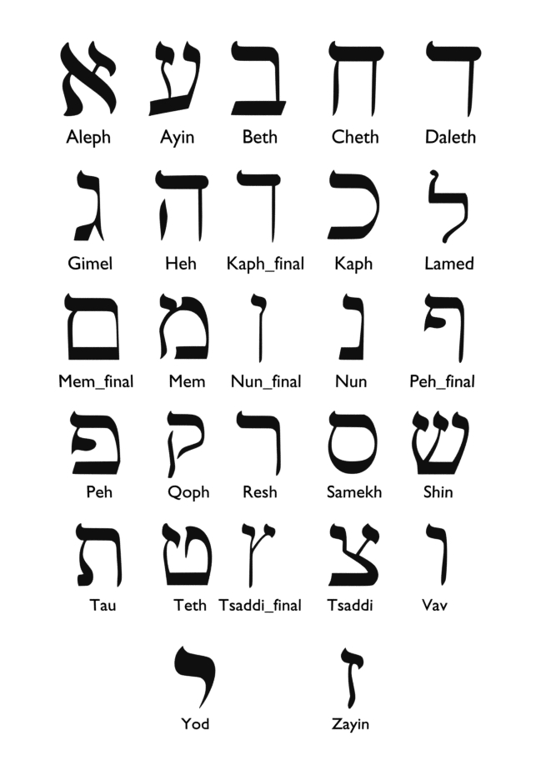
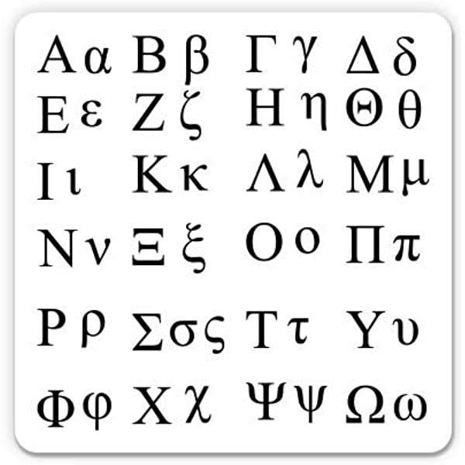
Hebrew
Greek

Slide 16
Aramaic
Aramaic was also a Semitic language.
Aramaic was first spoken by tribes in northern Mesopotamia, (modern day Iraq & Syria) as early at 1,000 B.C.
The language came to prominence during the Neo-Assyrian Empire (900-600 B.C.) and continued to be used during the Babylonian Empire (626-539 B.C.).

Slide 17
The Jews first started speaking Aramaic during the Babylonian Captivity and continued to use from then on down to the time of Christ.
Although the OT was written in Hebrew, Hebrew was not used as a common language until modern times when it was revived (late 19th and early 20th centuries).

Slide 18
Aramaic Language in the OT
Gen. 31:47 – Jegar Sahadutha (place)
Jeremiah 10:11 (one verse)
Daniel 2:4b-7:28 (about six chapters)
Ezra 4:8-6:18; 7:12-28 (3-4 chapters)
Lightfoot notes that if you look at these passages in the Hebrew Bible you cannot tell any difference, because “there is no difference in appearance between Hebrew and Aramaic.” (p. 28). But they are different languages.

Slide 19
Aramaic Language in the NT
“Empty headed” (Matt 5:22)
“Save now” (Hosanna, Matt 21:9 (2x), 15; Mark 11:9; John 12:13)
“My God, my God, why have you forsaken me?” (Mark 15:34)
“Little girl, rise.” (Mark 5:41)
“Be opened” (Mark 7:32)
“Rabbi” (Aram. Rabbouni; John 20:16)
“Father” (Aram. Abba; Mark 14:36; Rom 8:15; Gal 4:6)

Slide 20
Koine Greek
Koine Greek was a combination of two other Greek forms (Ionian and Attica).
Koine Greek became the lingua franca across the Eastern Mediterranean and Near East. (Common language among people with different languages).
After the conquest of Alexander (spread of Hellenism) Koine was spoken from Egypt to India.
After the Roman conquest, an unofficial bilingualism of Greek and Latin was established in Rome, and Koine became a first or second language in the Empire.

